Slide 1
03 | Web Workers

Slide 2
Module Overview
XML HTTP Request
Ajax
Web Sockets
SignalR

Slide 3
XML HTTP Request

Slide 4
Calling the server
One of the main goals of modern web applications is to mimic locally installed applications
The catch? A lot of the data and resources you need are on the server

Slide 5
Enter XML HTTP Request object
Originally created to support Outlook Web Access
Later added to Mozilla and became a de facto standard
Allows for "raw" calls to the server

Slide 6
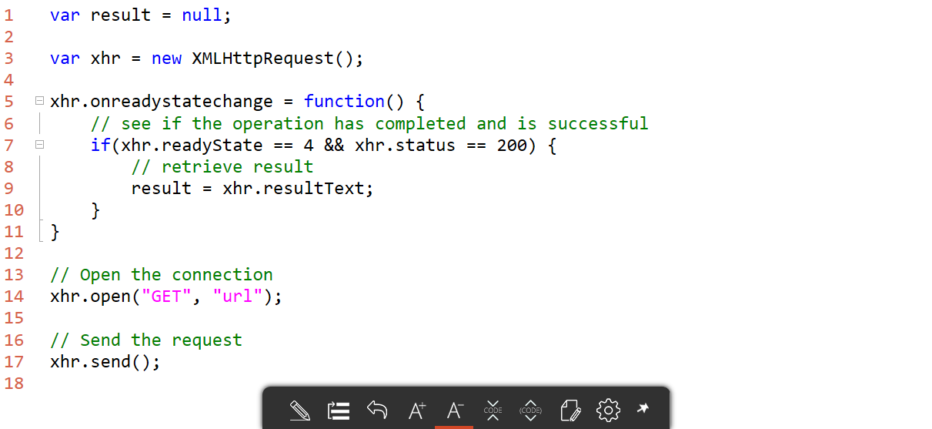
Sample call

Slide 7
XML HTTP Request

Slide 8
Ajax calls with jQuery

Slide 9
What is Ajax
"Asynchronous JavaScript and XML"
Set of commonly used standards and technologies for making server calls

Slide 10
jQuery support
jQuery (and other libraries) simplify making Ajax calls
Still uses XMLHttpRequest behind the scenes
Provides helper methods
$.get to retrieve text
$.getJSON to retrieve a JSON object

Slide 11
jQuery Ajax calls

Slide 12
Web sockets

Slide 13
What about the server calling the client?
If we're going to create a truly interactive site, the server needs to be able to update the client
Several technologies exist
W3C introduced Web Sockets as part of HTML5

Slide 14
Web Sockets
Similar to normal socket development
Client can call server
Server can call client
Uses messaging system
Similar to web workers
Supported by most modern browsers

Slide 15
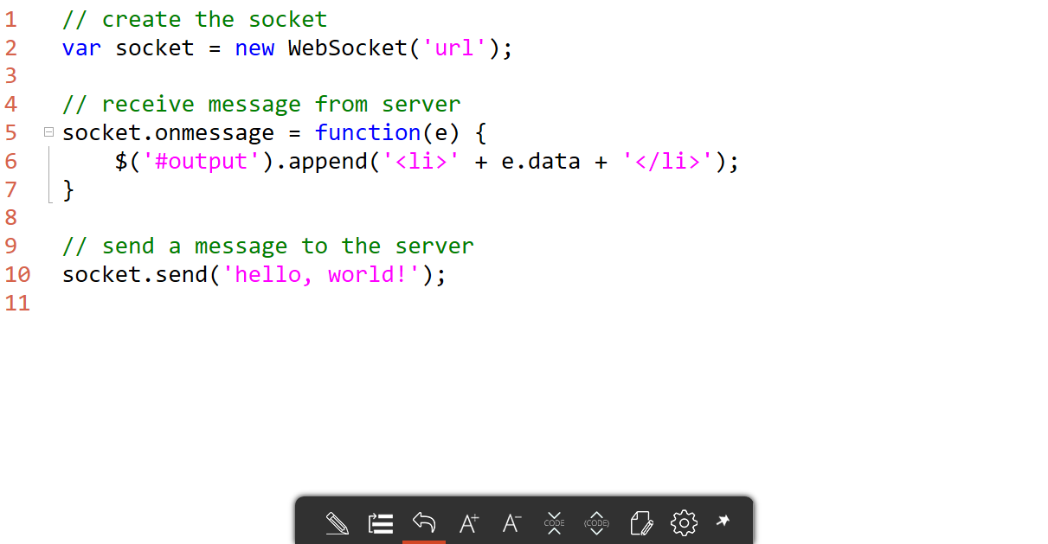
Client web sockets

Slide 16
Web sockets

Slide 17
SignalR

Slide 18
Web sockets are pretty rudimentary
One method (send) to send messages
One event (onmessage) to receive messages
You're responsible for handling serialization if you're using objects
No fallback if the browser doesn't support web sockets

Slide 19
Introducing SignalR
ASP.NET technology
Designed to abstract client/server interactions
Built-in fallback mechanisms
Built-in serialization
Everything just looks like normal objects

Slide 20
Hello, SignalR!

